Slide 1

General Biology
Dr. sraa nsayef

Slide 2
Kingdom Fungi
Lec ((9))

Slide 3
Eukaryotic, absorptive
Mostly multicellular (except few, e.g. yeast)
Heterotrophic (decomposers & parasitic)
Uses: (medicine, food)
Ecological value: (major decomposers, symbiotic relationships (N₂ fixers)
Problems: (some strains are deadly, athletes foot, destroy library books, destroy crops)
cell walls (generally of “chitin”)
“Spores” as reproductive bodies
Unique chromosomes and nuclei
Includes molds, yeasts, rusts, and mushrooms

Slide 4
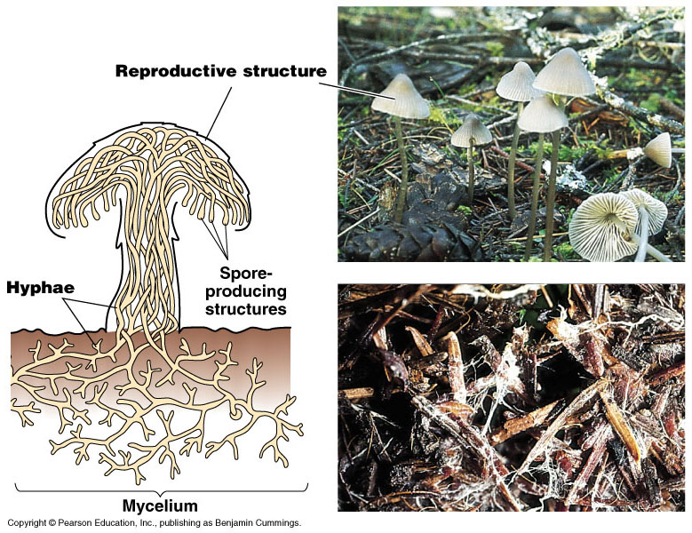
hyphae - the vegetative bodies of most fungi, constructed of tiny filaments
mycelium - mass of hyphae

Slide 5
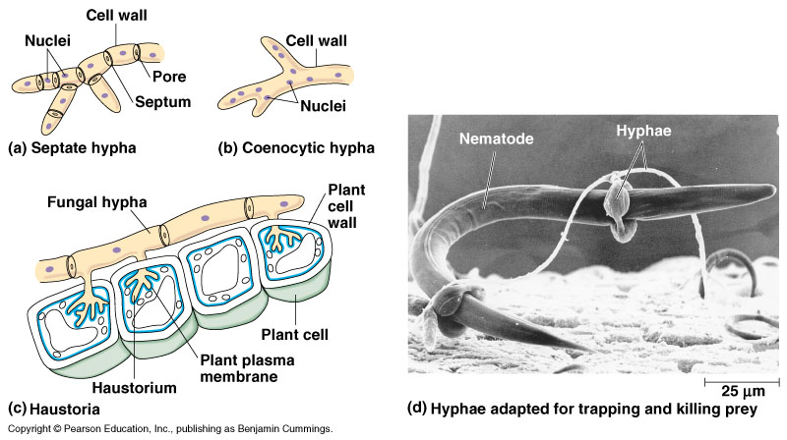
Type of hypha
1- Septate hypha:
multicellular
walls divided by septa
2- Ceonocytic hypha:
continuous cytoplasm mass
multinucleate
no septa

Slide 6
Haustoria:
Modified hyphae found in parasitic fungi
Function: absorb nutrients from host
Some fungi even have hyphae adapted for preying on animals.

Slide 7
Classification of Fungi
  Basidiomycota
  Ascomycota
  Zygomycota
  Deuteromycota

